Slide 1
Cataclysmic Variable Stars
Each is its own uniquely chaotic contact-dance, in which one star actively transfers a portion of its mass onto the surface of a white dwarf.

Slide 2
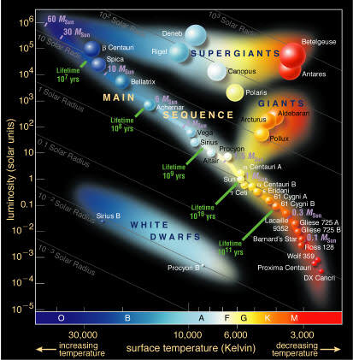
Hertzsprung-Russell (H-R) diagram of stars

Slide 3
Normal life cycle (“stellar evolution”) of stars with 0.4 < M/M_{Sun} < 8
Birth from dusty molecular gas cloud ~ (thousands to millions of years)
Main-sequence stage, core nuclear fusion of H to make He, luminosity, and lifetime depend on mass ~ (many millions to billions of years)
Subgiant stage, core H depleted, H fusion continues in a shell that surrounds a core of He ~ (thousands to millions of years)
Red giant stage, outer envelope expanded large as inner is crushed and surrounding shell of H fusion grows stronger
Horizontal branch stage / yellow giant, He fusion to make C ignites in core, outer envelope contracts a bit ~ (millions to hundreds of millions of years)
Asymptotic giant branch (AGB) stage / carbon star / Mira variable, bigger red giant, core He depleted, H-fusion shell surrounds He-fusion shell surrounds core of carbon. Convection brings carbon from the core to the surface. Surface is very cool, so particles of dust and soot form, outer layers begin to shed
Planetary nebula stage, outer layers puff away into space in a sequence of pulses that create a beautiful highly-structured nebula ~ (thousands of years)

Slide 4
After the “planetary nebula” is released into space, the core of the star remains as a “white dwarf”.
Extremely hot (initially > 100,000 K, but older white dwarfs may be as cool as ~6,000 K)
Extremely dense (may exceed several tons of mass in each cm³)!
Small– similar to Earth’s size
“Electron degenerate” material consists of electrons streaming in between the atomic nuclei. The electrons are packed to the maximum density allowed for the conditions.
More mass = stronger gravitational compression = higher density
For white dwarfs, more mass = smaller radius!
If enough mass is added to exceed the “Chandrasekhar limit” of ~1.4 M_{Sun}, the white dwarf explodes as a Type Ia supernova!

Slide 5
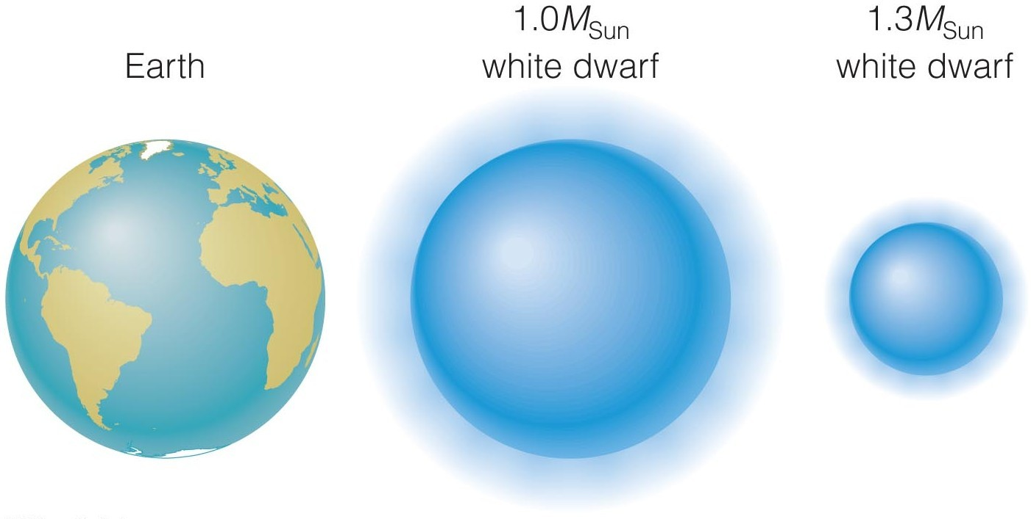

Slide 6
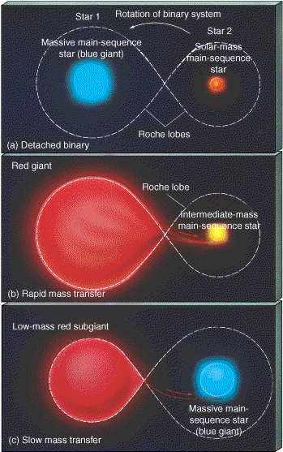
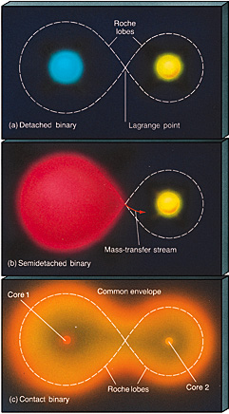
“Roche lobes” outline where matter that is “dropped” freely (with zero orbital velocity) would fall into one star of a binary system or the other.

Slide 7
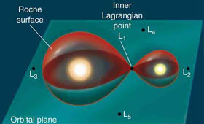

Slide 8
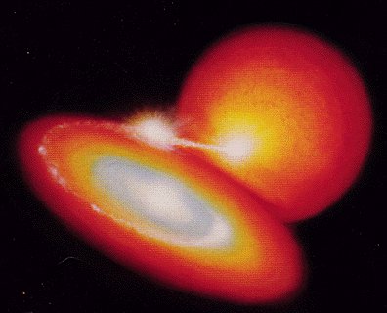
Typical CV, with accretion disk

Slide 9
The brightness of CVs varies for many reasons:
A Type Ia supernovae occurs if the Chandrasekhar mass limit is exceeded (single event; white dwarf is entirely destroyed!)
Novae occur if a layer of added hydrogen grows deep enough that nuclear fusion is ignited by pressure at the bottom of the layer
Helium fusion bursts occur (normally not as bright as novae) if a layer of added helium is the cause
“Dwarf novae” occur if an accretion disk switches from a low viscosity cooler condition to a high viscosity hotter condition. The hotter disk condition is triggered by the donor star adding mass to the disk faster than the disk empties onto the white dwarf, but a hot disk will then drain onto the white dwarf more efficiently, allowing the cooler disk condition to return.

Slide 10
The brightness of CVs varies for many reasons:
The “mass transfer rate” of material from the donor star into the white dwarf may change, for poorly understood reasons.
Starspots on the donor star may be an issue?
Overflowing Roche Lobes (such that mass transfer is not restricted to the L1 point) may be an issue?
Fast flickering occurs at “hot spots” where streams of infalling material impact directly upon either 1) the accretion disk or 2) the white dwarf surface if no accretion disk is present

Slide 11
Typical CV, with accretion disk

Slide 12
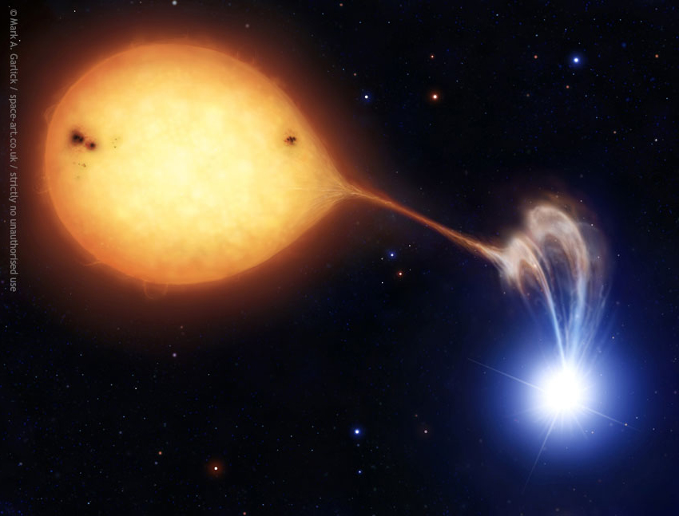
A “polar” is what we call it when the white dwarf is so extremely magnetic that the accretion is “streamed”. No accretion disk forms in this case!

Slide 13
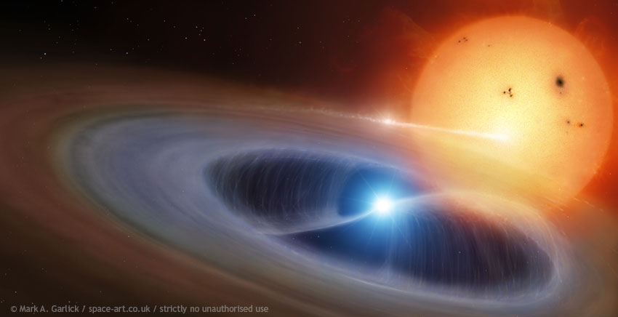
If the white dwarf is highly magnetic, but not enough to make a polar, we get an “intermediate” polar:

Slide 14
Our Target Objects:
HU Aqr, eclipsing polar with unexplained variations in orbital period
AM Her & V??? Lib, well known and poorly known “polar” examples
DQ Her, eclipsing intermediate polar and bright classical nova (1934)
SU UMa & AY Lyr, dwarf novae with outbursts that have a “superhump” feature
T CrB, recurrent nova (1787, 1866, 1946), giant star, next eruption due soon
V394 CrA & CI Aql, recurrent novae, subgiant stars?, next eruptions due soon
AM CVn, helium fusion bursts, both stars degenerate, superhumps
V Sge, only CV in which mass of the donor star is greater, fast shrinking orbit!
Ou 5, eclipsing central binary of a “planetary nebula”, not yet a CV system

Slide 15
What might our observations be able to tell us about these target objects?
The ones with white dwarf masses >1.3 M_{Sun} face likely destruction as Type Ia supernovae within an “astronomically short” time (perhaps millions of years at most). Anything and everything these systems are observed to do might improve our understanding of the precursors of these events.
Variations in brightness and color also may precede or follow nova eruptions, and we would like to better understand what causes these phenomena.
What causes some dwarf novae to display “superhumps”? How do these work?
Irregular behavior in both recurrent nova eruptions and dwarf nova disk outbursts can only be explained by variability in the mass transfer rate from the donor star. Why is the mass transfer rate so variable? (Because they lack accretion disks, polars offer “cleaner” observations of mass transfer variations.)
Can we gain more insights into the origins of the different types of CV systems?

Slide 16
We will be observing with a CCD camera equipped with a BVRI filter set.
A CCD (charge-coupled device) is a simple type of digital camera that is extremely sensitive to incoming particle quanta. It’s an array of sensitive semiconductor capacitors that can be discharged in a sequence. We can use this to obtain a decently accurate count of the number of individual photons of light that strike each pixel of the array during an exposure. (Unfortunately, it also responds to other energetic particles that hit it, making cosmic ray showers a particularly serious nuisance.)
A BVRI filter set is simply four pieces of colored plastic placed on a rotating wheel in front of the CCD camera. B = blue, V = “visual” green, R = red, and I = near infrared. Each plastic piece “filters” out photons of all other wavelengths of light except for the wavelengths (colors) that one wishes to observe.

Slide 17
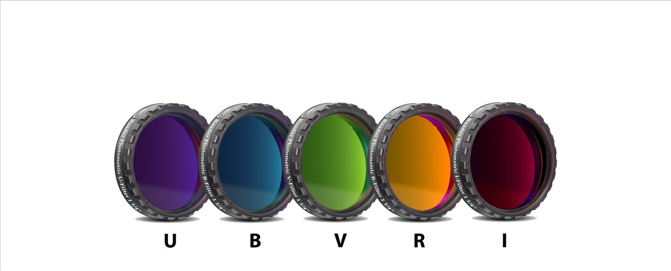
There’s also a less commonly used filter called “U” which allows only ultraviolet to pass through it (plus just a little bit of visible violet).

Slide 18
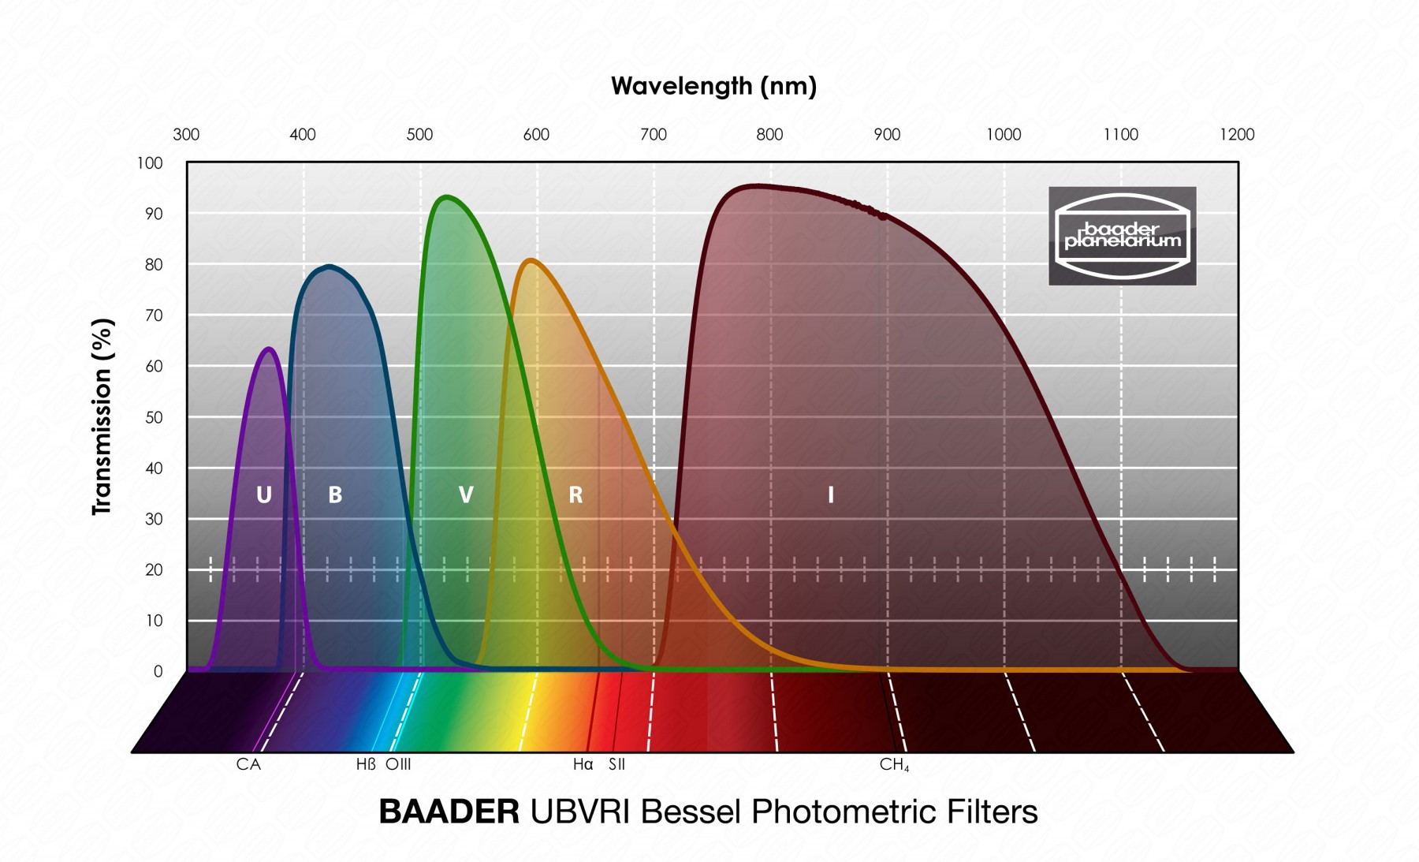

Slide 19
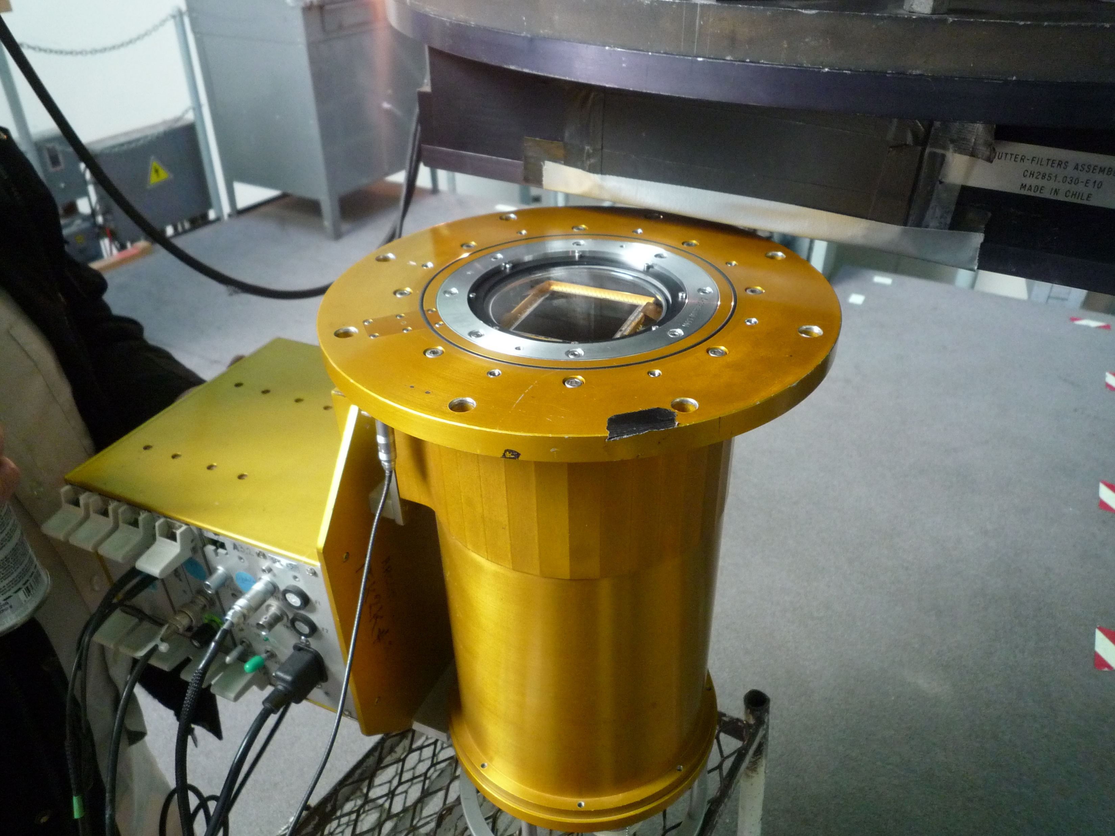
So now you know what astronomers mean when they tell us that they’re doing “UBV photometry” or “VRI photometry”, etc.!
Meanwhile, here’s what a CCD looks like:
The CCD is the square wafer at the top of this container. This type of container is called a “dewar”– it holds liquid nitrogen to keep the CCD very cold, which greatly improves its functionality and performance!

Slide 20
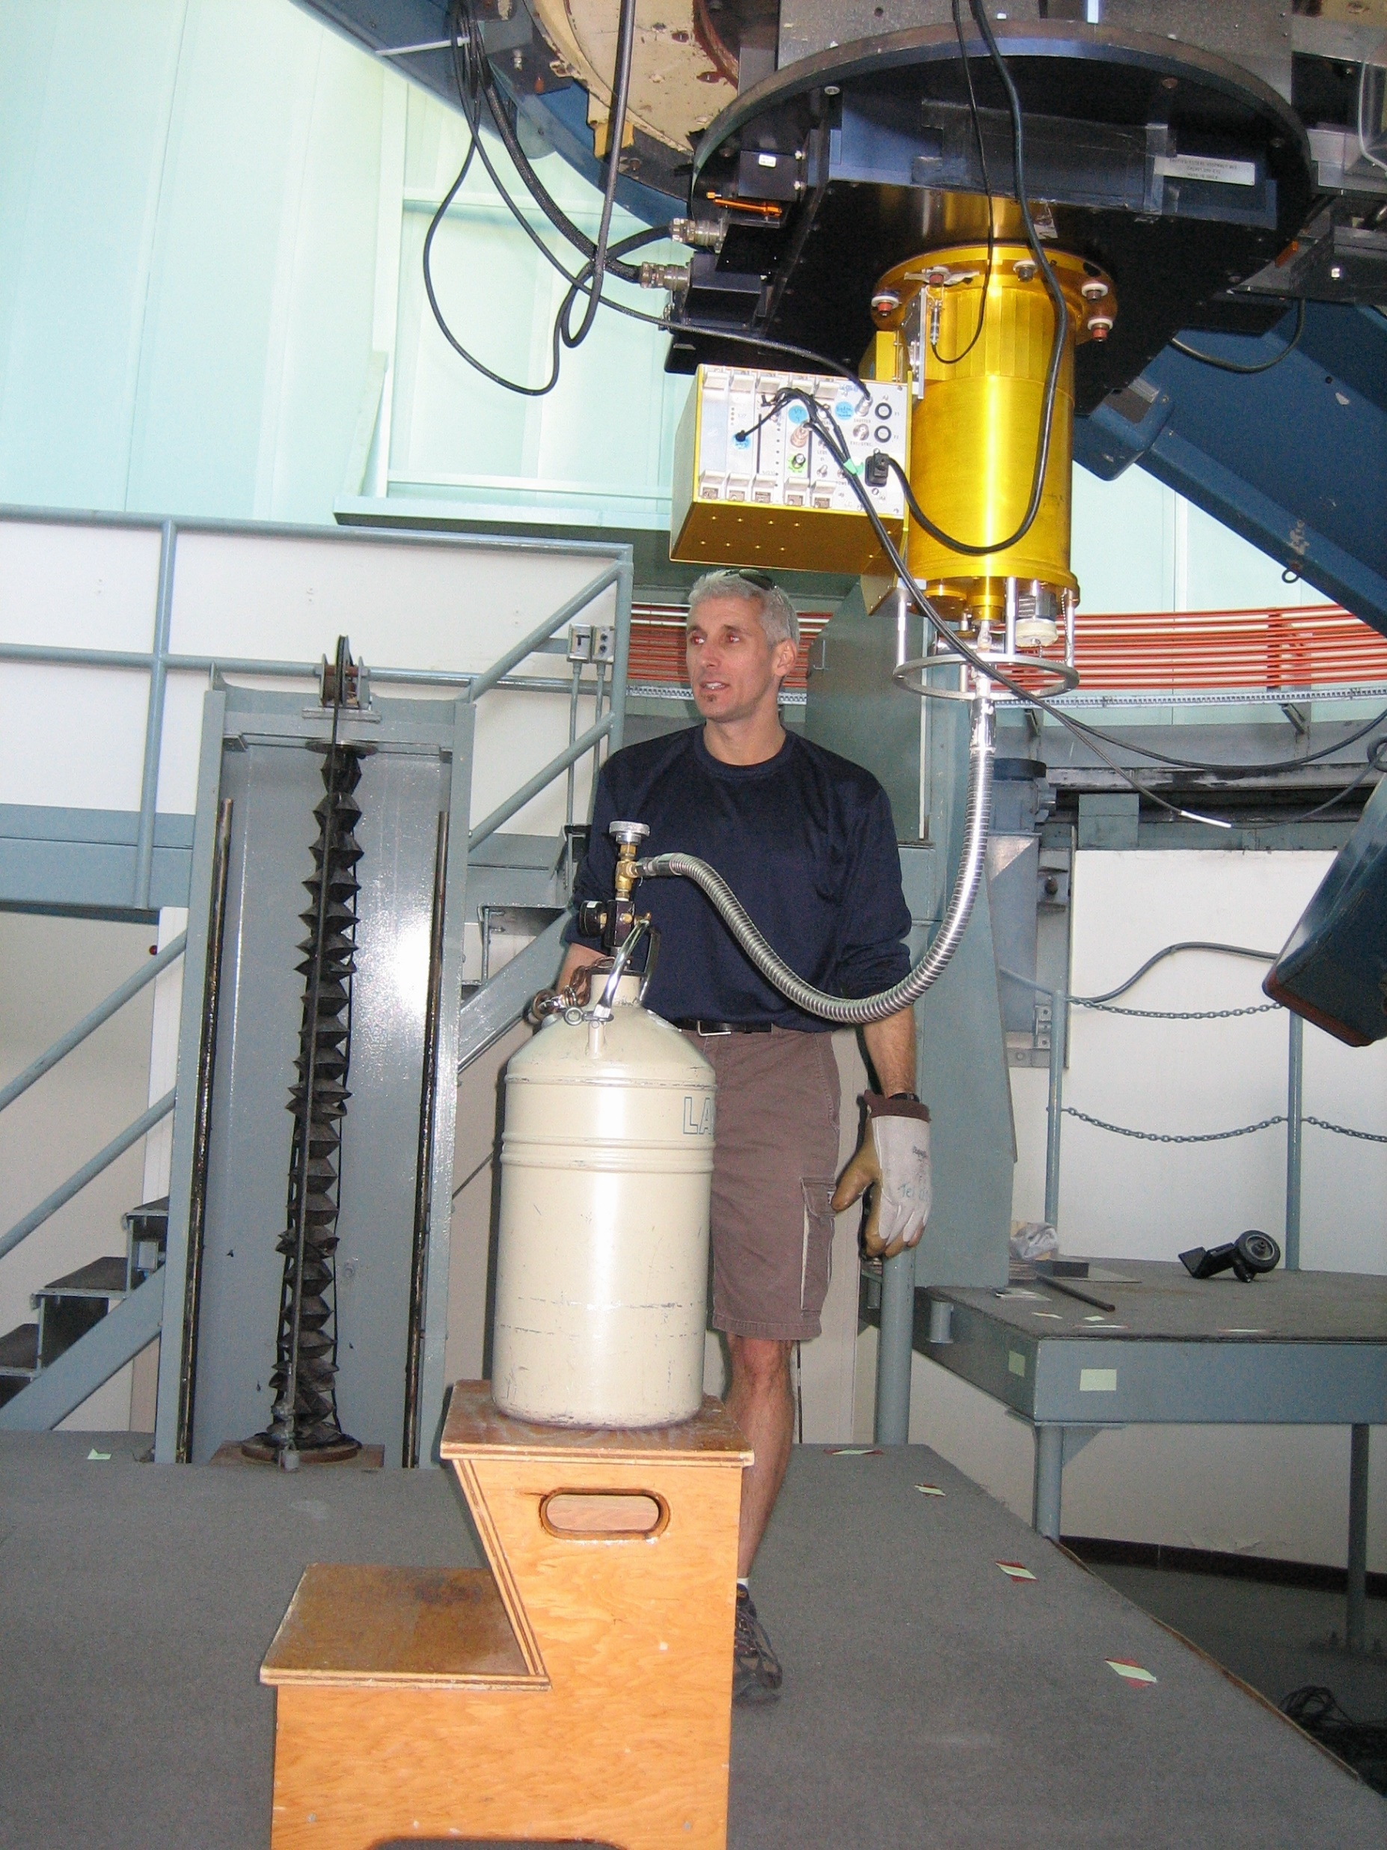
Adding liquid nitrogen to the dewar: (The cold reduces the “thermal noise” of the CCD chip. This is especially critical if you want to observe at infrared wavelengths.)

Slide 21
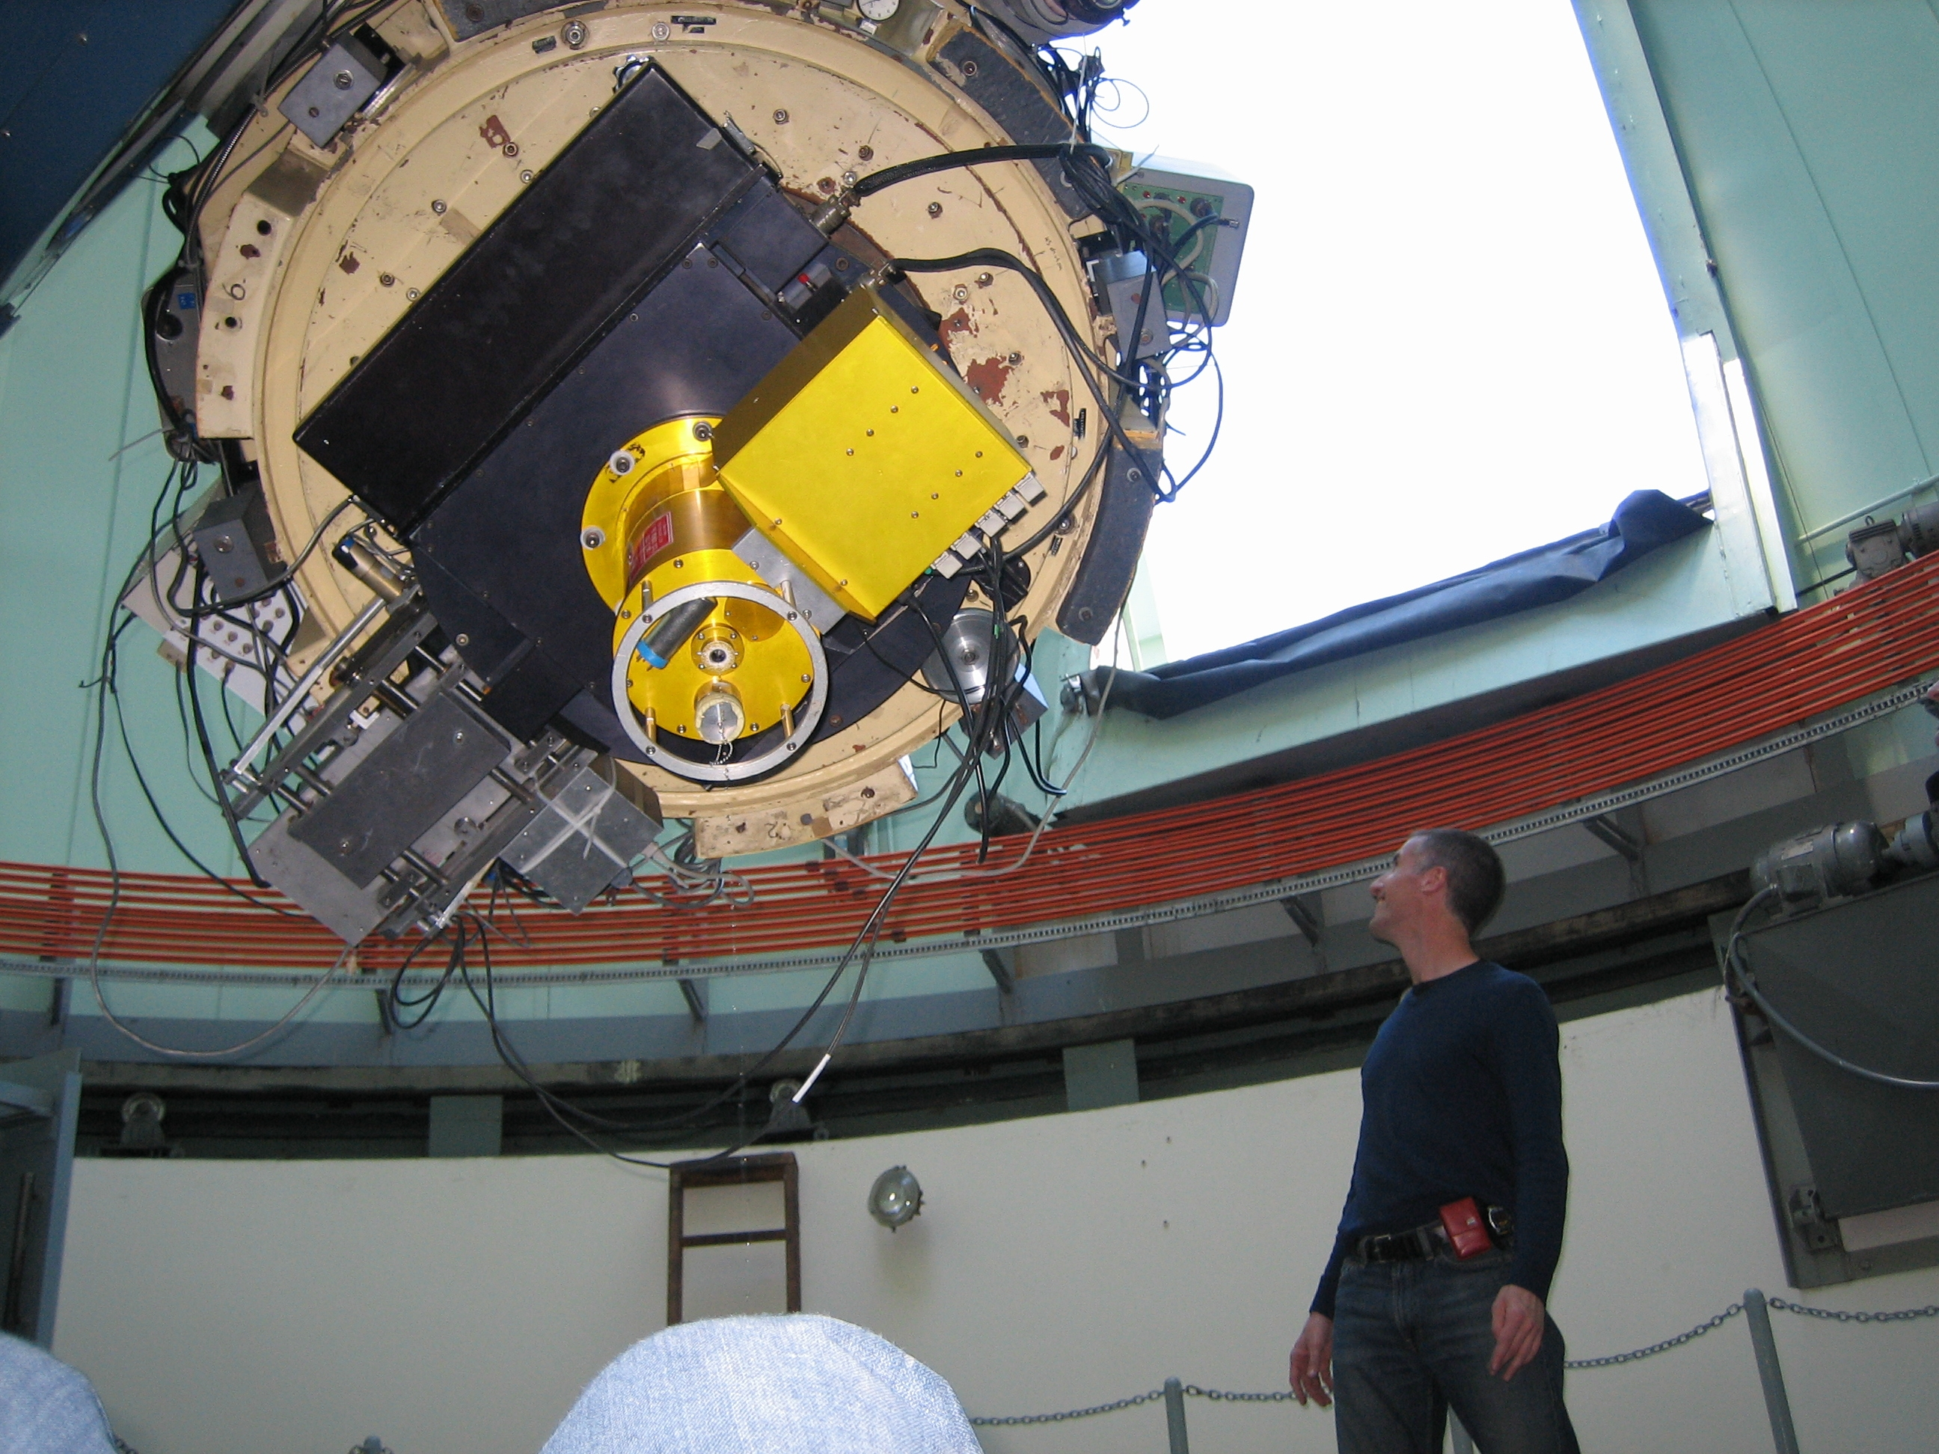
And we’re good for a night of observing!

Slide 22
We will want to obtain…
Measurements of comparative brightness, by consistently comparing the brightness of each target to other stars captured in the same camera images. (Through thin clouds or variable haze, this is all we can do!)
Measurements of absolute brightness, by calibrating all of our measurements obtained in the same night to well-observed “standard stars”. These standard stars must include at least one bluer star and one redder star, and the calibrations are only useful if the sky is perfectly clear in a consistent way (“photometric”) throughout the night.
Measurements of color, by observing through each of the B, V, R, and I filters and comparing differences in how bright our target appears in each case.
Measurements of eclipse timings, by noting as precisely as possible when a target rapidly dims. Observed timings are then compared with predictions to check for possible changes in a CV’s orbital period.

Slide 23
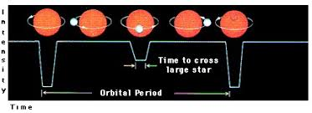
A simple example showing the concept of a “light curve” graph for an eclipsing binary system:

Slide 24
Details about how to predict exactly when eclipses should be expected involve three things that all observational astronomers should know:
The Julian Date system for keeping time
The need to correct the precise timing of any observations made on Earth to find out when the same events would have been seen at our Solar System’s barycenter (the center of gravity of our entire Solar System; a point that always is located very near to, or sometimes inside of, our Sun but is not at the center of the Sun).
Common conventions for recording the ranges of uncertainty in measurements.

Slide 25
Julian Day Numbers
A simple running count of the number of days passed since January 1, 4713 BC of the proleptic Julian calendar.
Starting in 4713 BC is useful for being earlier than any calendrical historical date records.
The choice of start date for this was adopted in 1583 in a very obscure manner. It is based on a once in every 7980 years convergence of a 28-year day-of-the-week calendar cycle, a 19-year lunar calendar cycle, and a 15-year cycle used by the Ancient Romans for collecting taxes.
Modern convention now begins each new Julian Date at 12:00 noon Greenwich Mean Time (GMT)– also known worldwide as “Universal Time” (UT)– and all fractions of a day are expressed in decimal format.

Slide 26
An example: What is the precise Julian Date at 11:00 PM Pacific Daylight Time (PDT) on June 10, 2024? PDT is 7 hours behind GMT (UT), so 23:00 PDT = 06:00 UT of the next calendar day (June 11, 2024) The Julian Date for this is 2460472.75 (Notice that this is 1/4th of one day before 12:00 noon UT.)

Slide 27
For precise timing of distant observed events in astronomy, Baryocentric Julian Dates must be used!
Earth is a moving object, and light from distant sources arrives at our planet at different times depending on Earth’s position.
The full diameter of Earth’s orbit spans 299,200,000 km = almost 17 light-minutes. Thus, depending on what time of year it happens to be (i.e. where Earth is in its orbit), we may observe an astronomical event several minutes earlier or later.
To correct for this in a consistent way, we must calculate when we would have observed the same event if we (hypothetically) were instead located at our Solar System’s baryocenter.

Slide 28
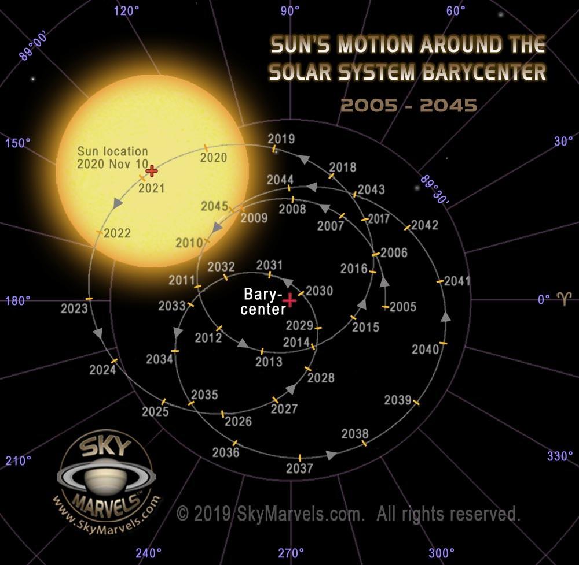
All of the planets in our Solar System pull the Sun in various different directions.
The strongest pull comes from Jupiter, the 2nd strongest from Saturn, etc.
This graphic shows the relative locations of the Sun and barycenter from 2005 to 2045.

Slide 29
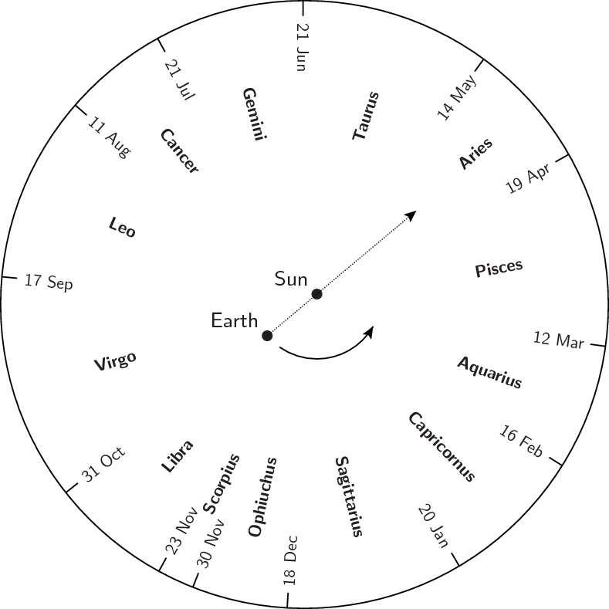
An example to illustrate the nature of the correction we need to make:
If the date is May 1st, and we’re looking at an eclipsing binary in Virgo or Libra, we’ll see the eclipses approximately 8 minutes before they’d be seen at the Solar System barycenter (near the Sun).
Conversely, the eclipses of a binary star system in Aquarius would not be visible on Earth until a few minutes after they’d be seen at the Solar System barycenter.

Slide 30
Many of the CVs on our target list are eclipsing systems. The eclipses allow us to measure their orbital periods, and we also will want to compare to past observations to discover if the orbital periods are changing in any way.
Here’s an “ephemeris” used to predict the exact times when the polar HU Aquarii will show a total eclipse (of the white dwarf):
BJD = 2449102.92061290(56) + E×0.0868203923138(74)
“BJD” here stands for Barycentric Julian Date, 0.0868203923138(74) is the measured orbital period of HU Aqr in days, and E is an integer that counts off each successive eclipse.

Slide 31
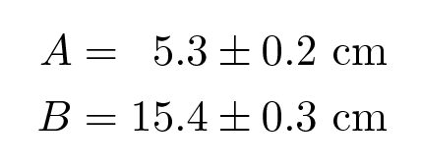
And that example introduces a common system used in physics and astronomy to indicate uncertainty ranges.
The “plus or minus” notation is familiar and intuitive:
But this becomes cumbersome if the number of digits is large. Instead, these same values could be written as
A = 5.3(2) cm and B = 15.4(3) cm .
The value in parenthesis is the uncertainty in the final digit (or in the last two digits, if that is indicated).

Slide 32
To close, we also should review the most basic steps of CCD image processing:
Every CCD is designed with a built in “bias” level of counts in each pixel. This bias (also called a “zero frame”) is usually the first thing that must be subtracted before an image can be analyzed.
Next after bias subtraction: Because each pixel in the CCD may have a different sensitivity, and (even more significantly) dirt on the telescope mirrors or on the filter wheel will result in an uneven distribution of light reaching the CCD, a “flat field” image must be obtained separately for each BVRI filter, and the appropriate flat field must be divided out before an image can be analyzed.
Finally, bad pixels and hits by cosmic ray particles must be pruned from the image. (Software programs can fill in best guesses for the missing bits; but, of course, this can’t be done with certainty.)

Slide 33
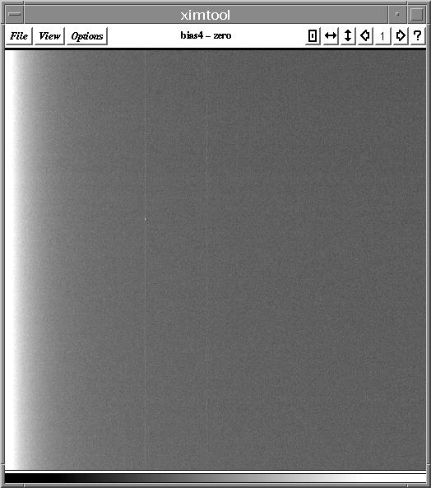
This is an example of what a “bias” typically looks like: It’s the result of a zero second exposure, so it’s also called a “zero”. The bias/zero must be subtracted from every image.

Slide 34
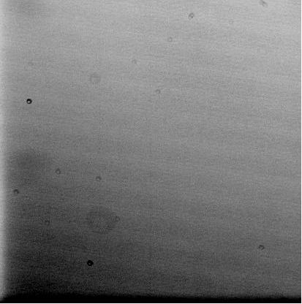
And here is a representative example of a “flat field” image. Images are “flattened” by dividing each pixel of their bias-subtracted versions by the corresponding pixel value from the appropriate flat field.
Notice the dark donut shapes? Those are out-of-focus shadows from specks of dust in various parts of the telescope and/or camera. Some dust donuts are large and ghostly; others are smaller and shaper.

Slide 35
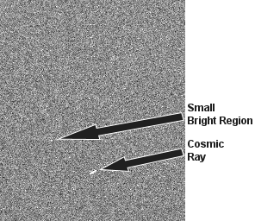
Finally, this image shows what hits by cosmic ray particles can do:
They’re nasty! Almost all images will contain at least a couple of these. And if a really high energy cosmic ray particle strikes the atmosphere above the observatory, CCD images can be ruined in hundreds of different places by the resulting shower.
Fortunately, software is pretty good about removing these things. But a direct hit at the image location of your target object will degrade the quality of your data.

